Slide 1
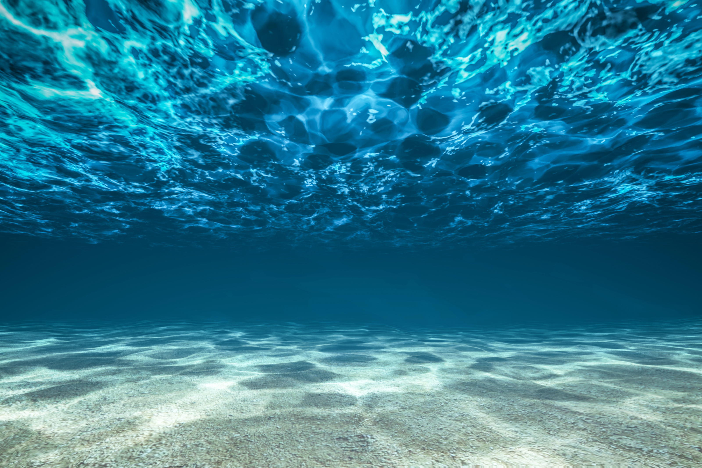
Testbed for IoUT
Felipe Bahamondes, Mathias Markvardsen, Morten Henriksen

Slide 2
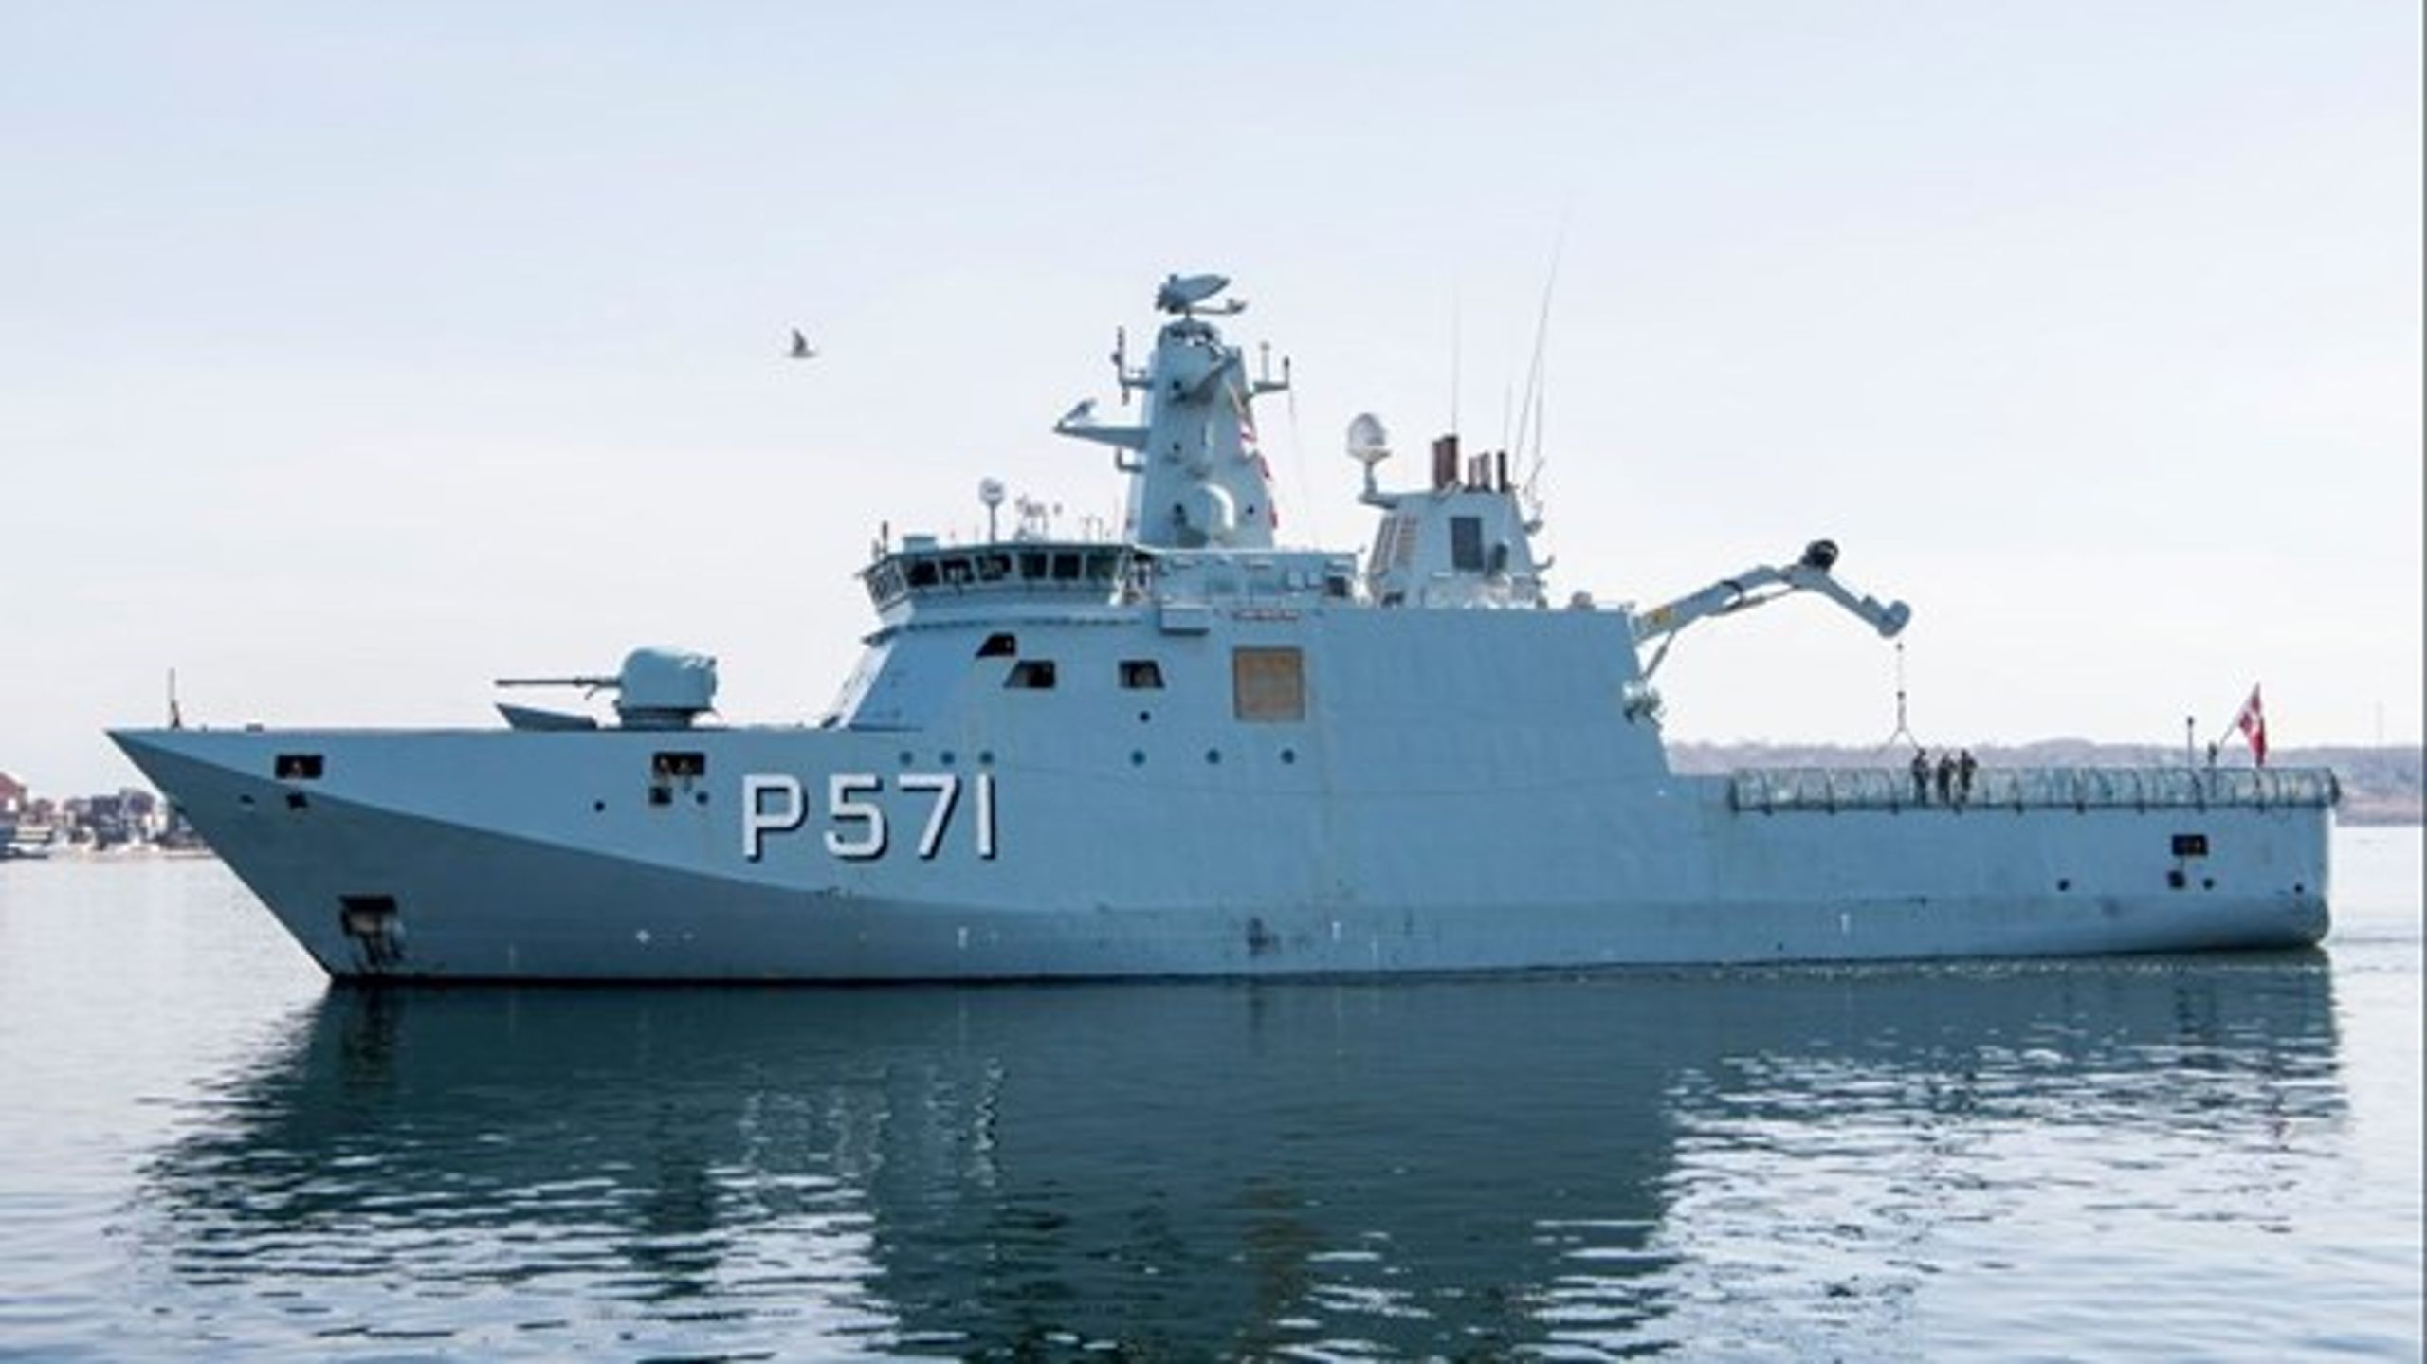
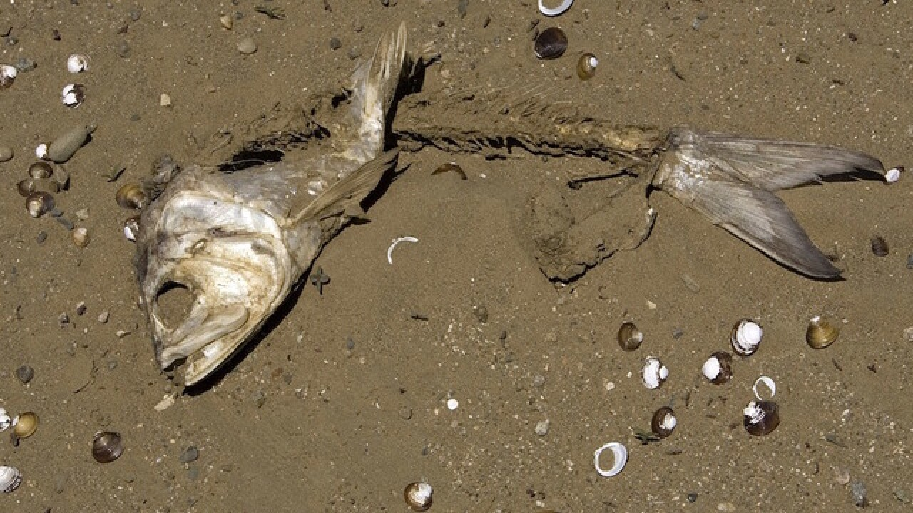
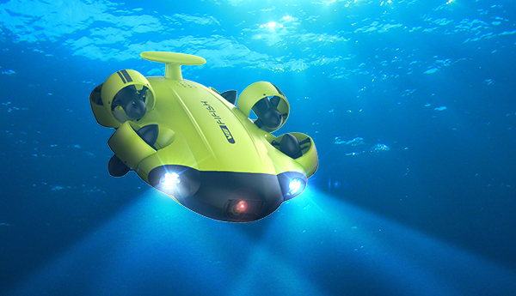
Motivation
To facilitate a test bed that will act as reference frame for researchers to compare their innovations

Slide 3
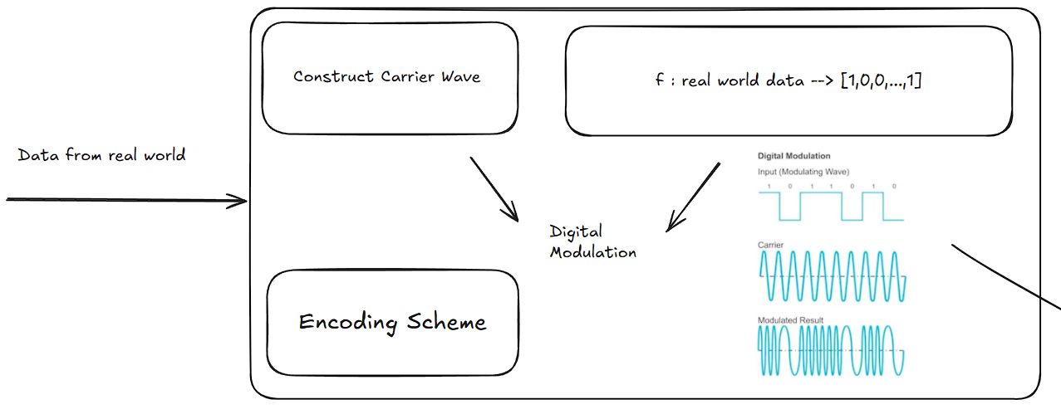
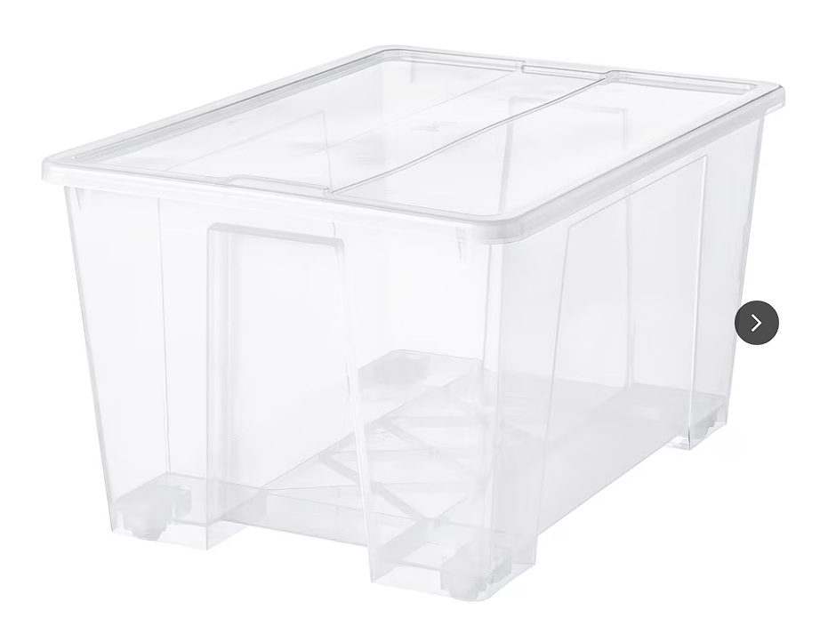
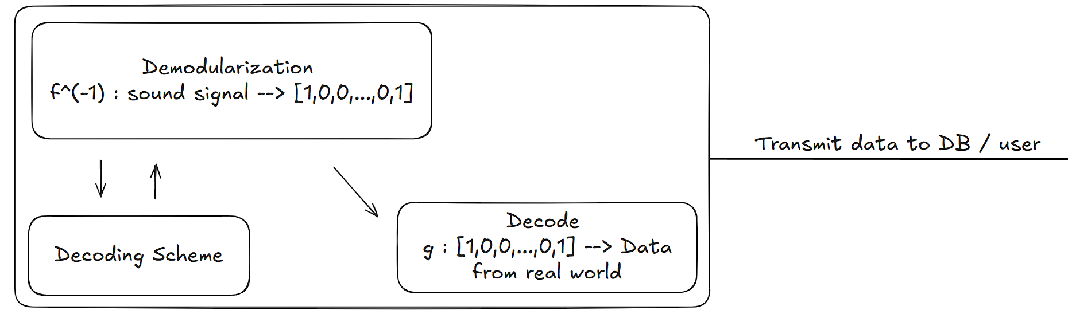
Send signal as sound wave
WATER
Notes:
Results, struggles, bugs, future goals

Slide 4

Questions?

